Slide 1
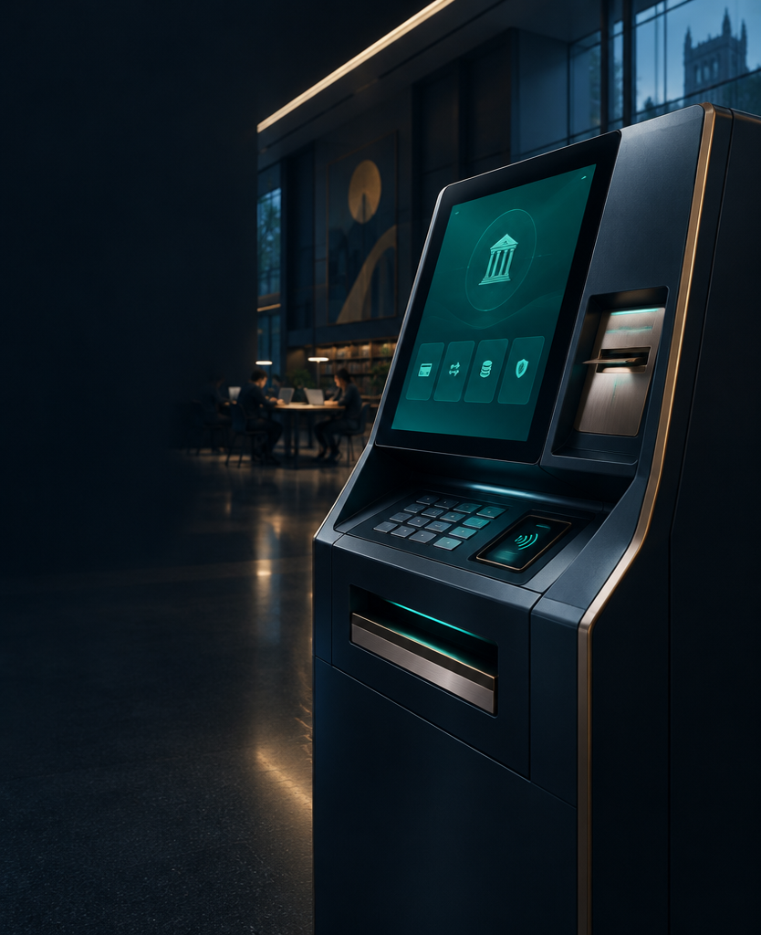
VIRTUAL BANKING
TERMINAL
A Java-Based ATM Simulation System
TEAM NUMBER — 11
STUDENT NAMES & ROLL NUMBERS — 1. 2620030124 Mokshit
2. 2620030110 Vaideesh
3. 2620030606 Veda Chandra
FACULTY NAME — Dr.Rajesh
16 OCTOBER 2026
01

Slide 2
ABSTRACT
One console-based system integrates authentication, transactions, persistence and analytical processing into a coherent learning model.
USER
PIN / ACCOUNT-ID
VERIFICATION
BANKING MENU
TRANSACTION
PROCESSING
BALANCE UPDATE
3-attempt PIN authentication
Balance, deposits & withdrawals
Four-note denomination logic
Runtime transaction history
Recursive future balance estimate
accounts.txt persistence
Invalid-input & funds exceptions
Collections and stream processing
02

Slide 3
SIX PRACTICAL PROBLEMS.
ONE INTEGRATED SYSTEM.
PROBLEM
SOLUTION
1 Safe ATM learning environment
Guided console simulation
2 Accurate balances & funds checks
Arithmetic + custom exceptions
3 Systematic withdrawal notes
Four-denomination breakdown
4 Organized transaction records
In-memory ArrayList history
5 Persistent balances
accounts.txt read / write
6 Reliable input & error handling
Trimmed input + exception management
03

Slide 4
CO1 / THINK IN SYSTEMS
ACCOUNT 101
ASHA
₹5,000
PIN protected · ArrayList history
INPUT
PROCESS
OUTPUT
Account ID · PIN · menu choice · amount
Authenticate · update balance · record transaction · estimate future value
Messages · balances · statements · denomination breakdown
Variables and constructors model state; [500, 200, 100, 50] models cash. Decomposition separates authentication, deposit, withdrawal, statement, persistence and future value into manageable responsibilities.
04

Slide 5
CO2 / CONTROL THE SESSION
START
Three failed credential attempts end the session with a blocked-card message. Valid access opens a six-option menu; invalid selections are handled, and the loop continues until Exit saves accounts.
LOAD ACCOUNTS
ENTER ID + PIN
INCORRECT?
RETRY ≤ 3
3 FAILURES
BLOCK + END
VERIFY
BANKING MENU
6 OPTIONS
EXECUTE OPERATION
EXIT?
SAVE + END
05

Slide 6
CO3 / DECOMPOSE. REPEAT. RETURN.
WITHDRAWAL · ₹850
RECURSIVE FUTURE VALUE · 5%
1 INPUT AMOUNT
YEAR 3
2 VALIDATE
YEAR 2
3 DEDUCT
YEAR 1
4 RECORD WITHDRAW
YEAR 0
BASE CASE
5 ARRAY [500, 200, 100, 50]
6 DISPLAY NOTES
FINAL ESTIMATE
1×₹500 + 1×₹200 + 1×₹100 + 1×₹50
YEAR 0 is the base case: the stopping condition. This is an educational growth estimate—not a full banking interest model.
06

Slide 7
CO4 / MODEL RESPONSIBILITY
ACCOUNT OBJECT
CONTROLLED FAILURE
Insufficient funds → friendly message
Invalid number → retry
Non-positive amount → reject
ATM APPLICATION
Account ID + holder
PIN verification
Balance state
Transaction ArrayList
Deposit + withdrawal methods
Exceptions protect the experience: problems become explicit, recoverable responses without exposing implementation details.
07

Slide 8
CO5 / FROM TEXT TO PERSISTENCE
trim spaces · UPPERCASE welcome · split comma fields · parse colon entries
accounts.txt
FILE STORAGE
READ SAFELY
HASHMAP
SAVED ACCOUNTS
BANKING
IN MEMORY
WRITE UPDATED
BALANCES
accounts.txt
UPDATED
Transaction history lives only during execution. If reading fails, default accounts are created; if writing fails, a clear save error is shown.
08

Slide 9
CO6 / COLLECTIONS BECOME INSIGHT
ARRAYLIST
DEPOSIT ₹1,000
WITHDRAW ₹500
DEPOSIT ₹2,000
TRANSACTION HISTORY
FILTER DEPOSITS
EXTRACT AMOUNTS
SUM TOTAL
DISPLAY TOTAL DEPOSITS
ALL ACCOUNTS / HASHMAP
SORT BALANCE ↓
COLLECT HOLDER NAMES
RICHEST → POOREST
Lambdas and method references keep each transformation concise while connecting functional programming directly to useful banking behavior.
09

Slide 10
SIX OUTCOMES.
ONE WORKING SIMULATION.
FUTURE SCOPE
Stronger authentication
More user accounts
Enhanced validation
Persistent transaction history
Graphical interface
Database integration
Credential encryption
CURRENTLY DEMONSTRATED
01 Foundations & computational thinking
02 Selection & iteration
03 Methods, recursion & arrays
04 OOP & exception handling
05 Strings & file I/O
06 Collections & streams
10

Slide 11
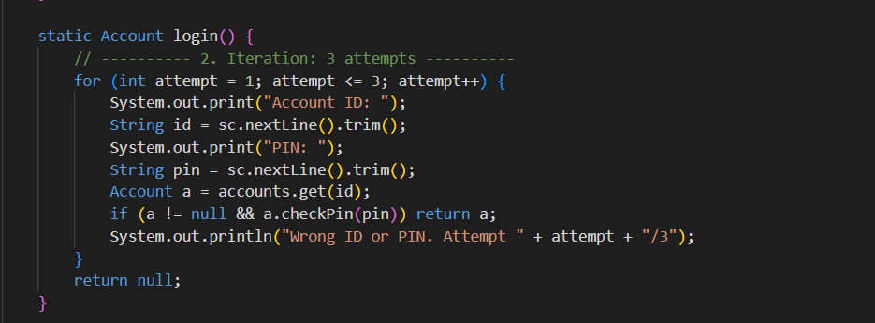
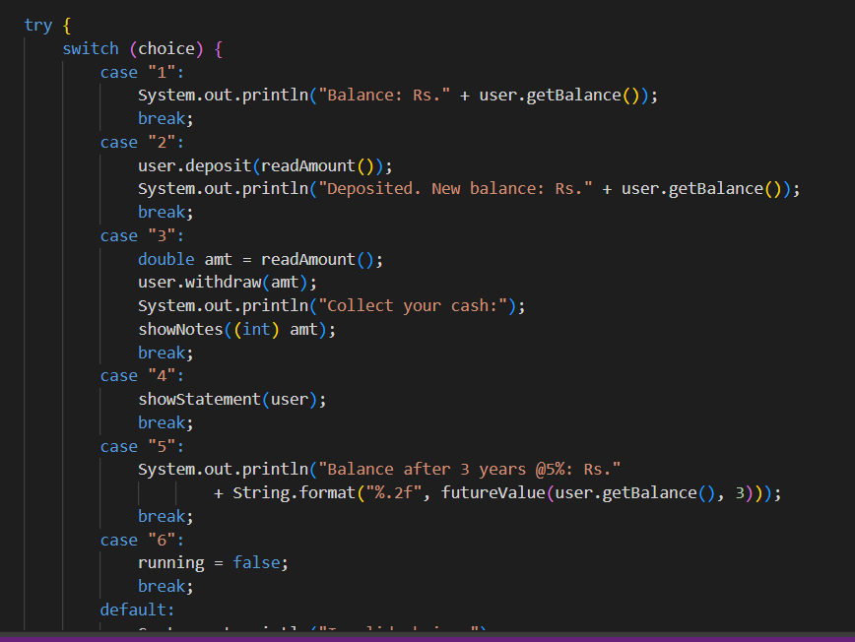
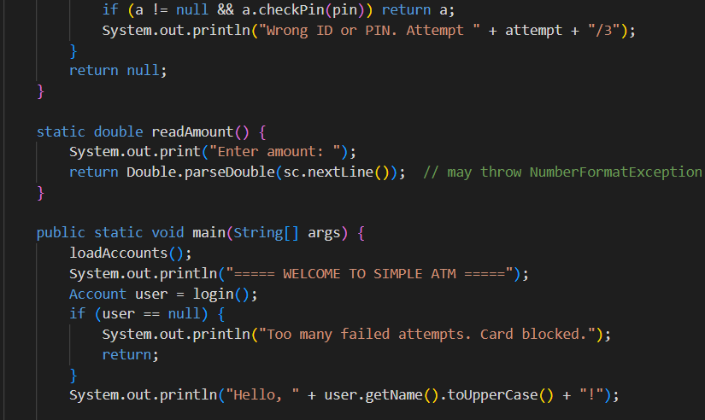
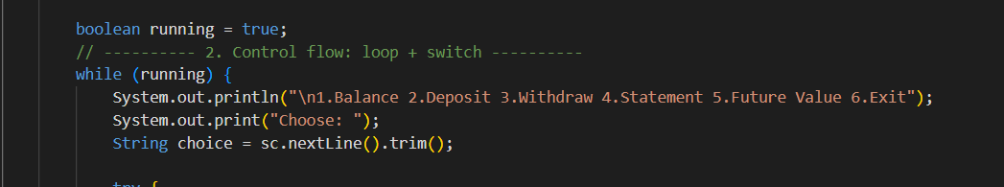
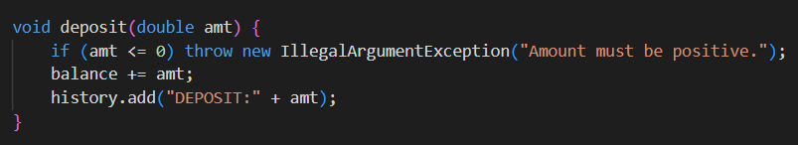
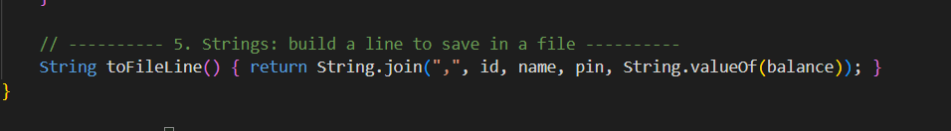
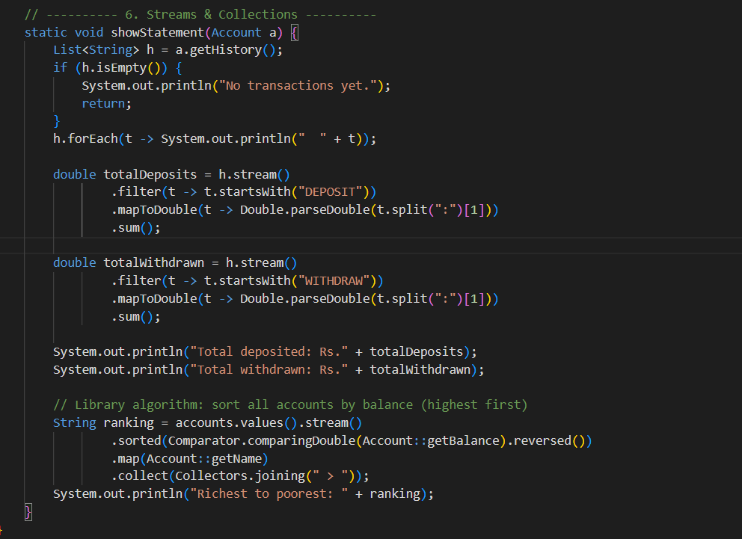
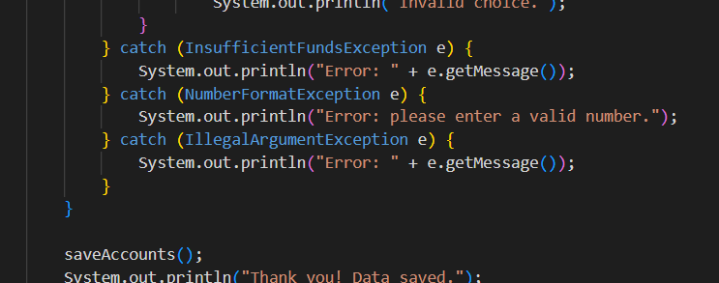
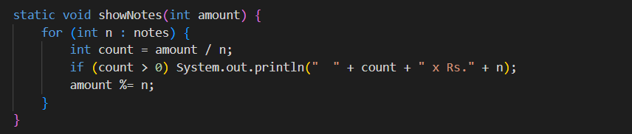
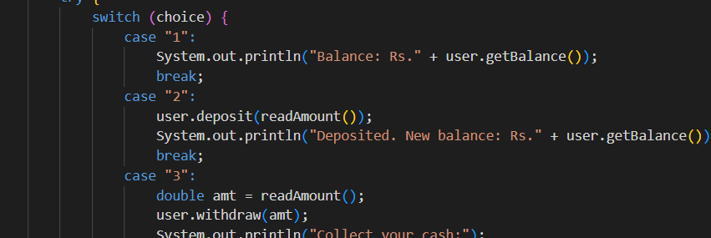
PROGRAM SCREENSHOTS
Successful Authentication Message
Banking Menu Display
Balance Inquiry Output
PIN Entry Screen
Deposit Operation Input / Output
Withdrawal + Denomination Breakdown
Transaction Statement Display
Error Handling Message
11

Slide 12
PROJECT EVIDENCE & REPOSITORY
Virtual Banking Terminal
Java Project Repository
GEO-TAGGED TEAM PHOTOGRAPH
PHOTO PLACEHOLDER
[ Insert GitHub Repository URL Here ]
QR CODE
PLACEHOLDER
15 OCTOBER 2026 · [ COLLEGE BRANDING ]
12

